Slide 1
Getting Started with React
React in a single HTML file

Slide 2
Getting Started with React
React fundamentals
JSX
Rendering model
Dynamic UI thinking

Slide 3
The Core Idea of React
UI as a Function of Data
React changes how we think about UI
UI is not manually built DOM
UI is described, not constructed
“User interfaces can be treated as data.”

Slide 4
The Mental Model Shift
Traditional approach:
Imperative DOM manipulation
Manual updates on change
React approach:
Declarative UI
Describe “what UI should look like”
UI = function(state)
Same Outcome, Different Thinking Model.

Slide 5
Example: Toggle Button
We want a simple UI behavior:
Button starts as “OFF”
Click toggles ON/OFF
Background color changes
This is a small problem—but reveals a big architectural difference

Slide 6
Imperative Approach (Traditional DOM)
You control every step
Select DOM element manually
Track state manually
Update DOM manually on events
Key idea: You tell the browser exactly what to do

Slide 7
// Imperative Code Flow
const button = document.getElementById('btn');
let isOn = false;
button.addEventListener('click', () => {
isOn = !isOn;
if (isOn) {
button.textContent = 'ON';
button.style.backgroundColor = 'green';
} else {
button.textContent = 'OFF';
button.style.backgroundColor = 'red';
}
});

Slide 8
Imperative Characteristics
Direct DOM manipulation
Manual state tracking
Explicit update logic per interaction

Slide 9
Imperative Risk (Scaling Problem)
UI logic spreads across event handlers
State and UI can become out of sync
Leads to “spaghetti code”
Hard to maintain as complexity grows

Slide 10
Declarative Approach (React)
Define UI based on state
React handles DOM updates
No manual DOM manipulation
Key idea: You describe what UI should be

Slide 11
// declarative code flow
function ToggleButton() {
const [isOn, setIsOn] = React.useState(false);
return (
<button
onClick={() => setIsOn(!isOn)}
style={{ backgroundColor: isOn ? 'green' : 'red' }}
>
{isOn ? 'ON' : 'OFF'}
</button>
);
}

Slide 12
Declarative Characteristics
UI is a function of state
No direct DOM manipulation
State change triggers re-render
React handles DOM updates automatically

Slide 13
Core Mental Model: UI = f(state)
State changes → UI recalculates
React compares old vs new UI
Only necessary DOM updates applied

Slide 14
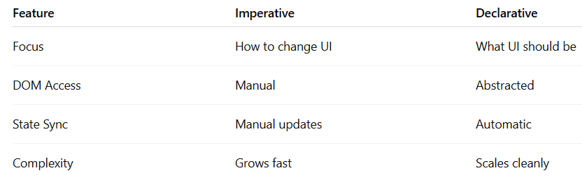
Key Comparison

Slide 15
Conceptual Shift
Imperative thinking
“What steps do I execute?”
Declarative thinking
“What should the result be?”

Slide 16
Why This Matters
Foundation of React architecture
Enables scalable UI systems
Reduces manual DOM complexity
Improves maintainability

Slide 17
Transition Question (Next Concept)
How does this model scale when:
Multiple components interact?
State is shared across UI parts?
Applications become large?
👉 This leads to: Component architecture + state management

Slide 18
React in Its Simplest Form
React can run directly in HTML via CDNs:
Key idea:
No build tools needed initially
Everything runs directly in the browser
Core Libraries (CDN Links)
React
React (Core Library) CDN
ReactDOM
ReactDOM CDN
Babel (JSX Compiler)
Babel Standalone CDN

Slide 19
Role of React & ReactDOM
React (Core Library)
Creates UI elements
Handles component logic
ReactDOM
Connects React to browser DOM
Handles rendering
React builds UI, ReactDOM displays it

Slide 20
Role of Babel
Babel acts as a transpiler
Converts JSX → JavaScript
Enables modern JS compatibility
Key trigger:
type="text/babel"

Slide 21
JSX Transformation
JSX looks like HTML:
<h1>Hello</h1>
But becomes:
React.createElement("h1", null, "Hello");
Key insight: JSX is JavaScript, not HTML

Slide 22
React Elements as Objects
{
type: "button",
props: {
children: "Click me"
}
}
JSX compiles into objects:
Key idea:
UI becomes structured data
Not DOM nodes

Slide 23
Rendering in React
Three-step process:
Select container
Create root
Render element
ReactDOM.createRoot(container).render(ui);

Slide 24
UI as Variables
React elements can be stored.
Implication:
UI is reusable
UI is composable
UI behaves like data
const button = <button>Good job!</button>;

Slide 25
Embedding JavaScript in JSX
Use {} to inject JS.
Key idea:
JS inside UI
Dynamic rendering
Computed values supported
<p>Cost: {10 + 5}</p>

Slide 26
Building Dynamic UIs
Example:
Product cost
Shipping cost
Total cost
Principle: UI should derive from data, not hardcoding
<p>Total: {productCost + shippingCost}</p>

Slide 27
External Libraries Integration
React is library-agnostic:
Works with APIs
Works with utilities
Works with external data
// Example: Day.js
dayjs().format("MMMM D");
// Used inside JSX:
<p>Today is {dayjs().format("MMMM D")}</p>

Slide 28
Re-rendering Concept
Initial limitation: UI does NOT auto-update
Solution: Re-render UI repeatedly
setInterval(() => {
root.render(...);
}, 1000);

Slide 29
React Reconciliation
What happens on update:
New UI is generated
React compares versions
Only changes updated DOM parts
Efficient DOM synchronization

Slide 30
Evolution of React Thinking
Stages:
Static UI
Structured UI
Dynamic values
External data
Reactive updates

Slide 31
Final Mental Model
Core React principle: UI is a function of data
Flow:
Define UI (JSX)
Render UI (ReactDOM)
Update UI (re-render/state)

Slide 32
Key Takeaway
React transforms frontend development:
From: DOM manipulation
To: State-driven UI systems

Slide 33
Toward Components & State
Modern abstraction:
Enables scalable UI systems
function Clock() { ... } // Components
const [time, setTime] = useState(...) //State

